Slide 1
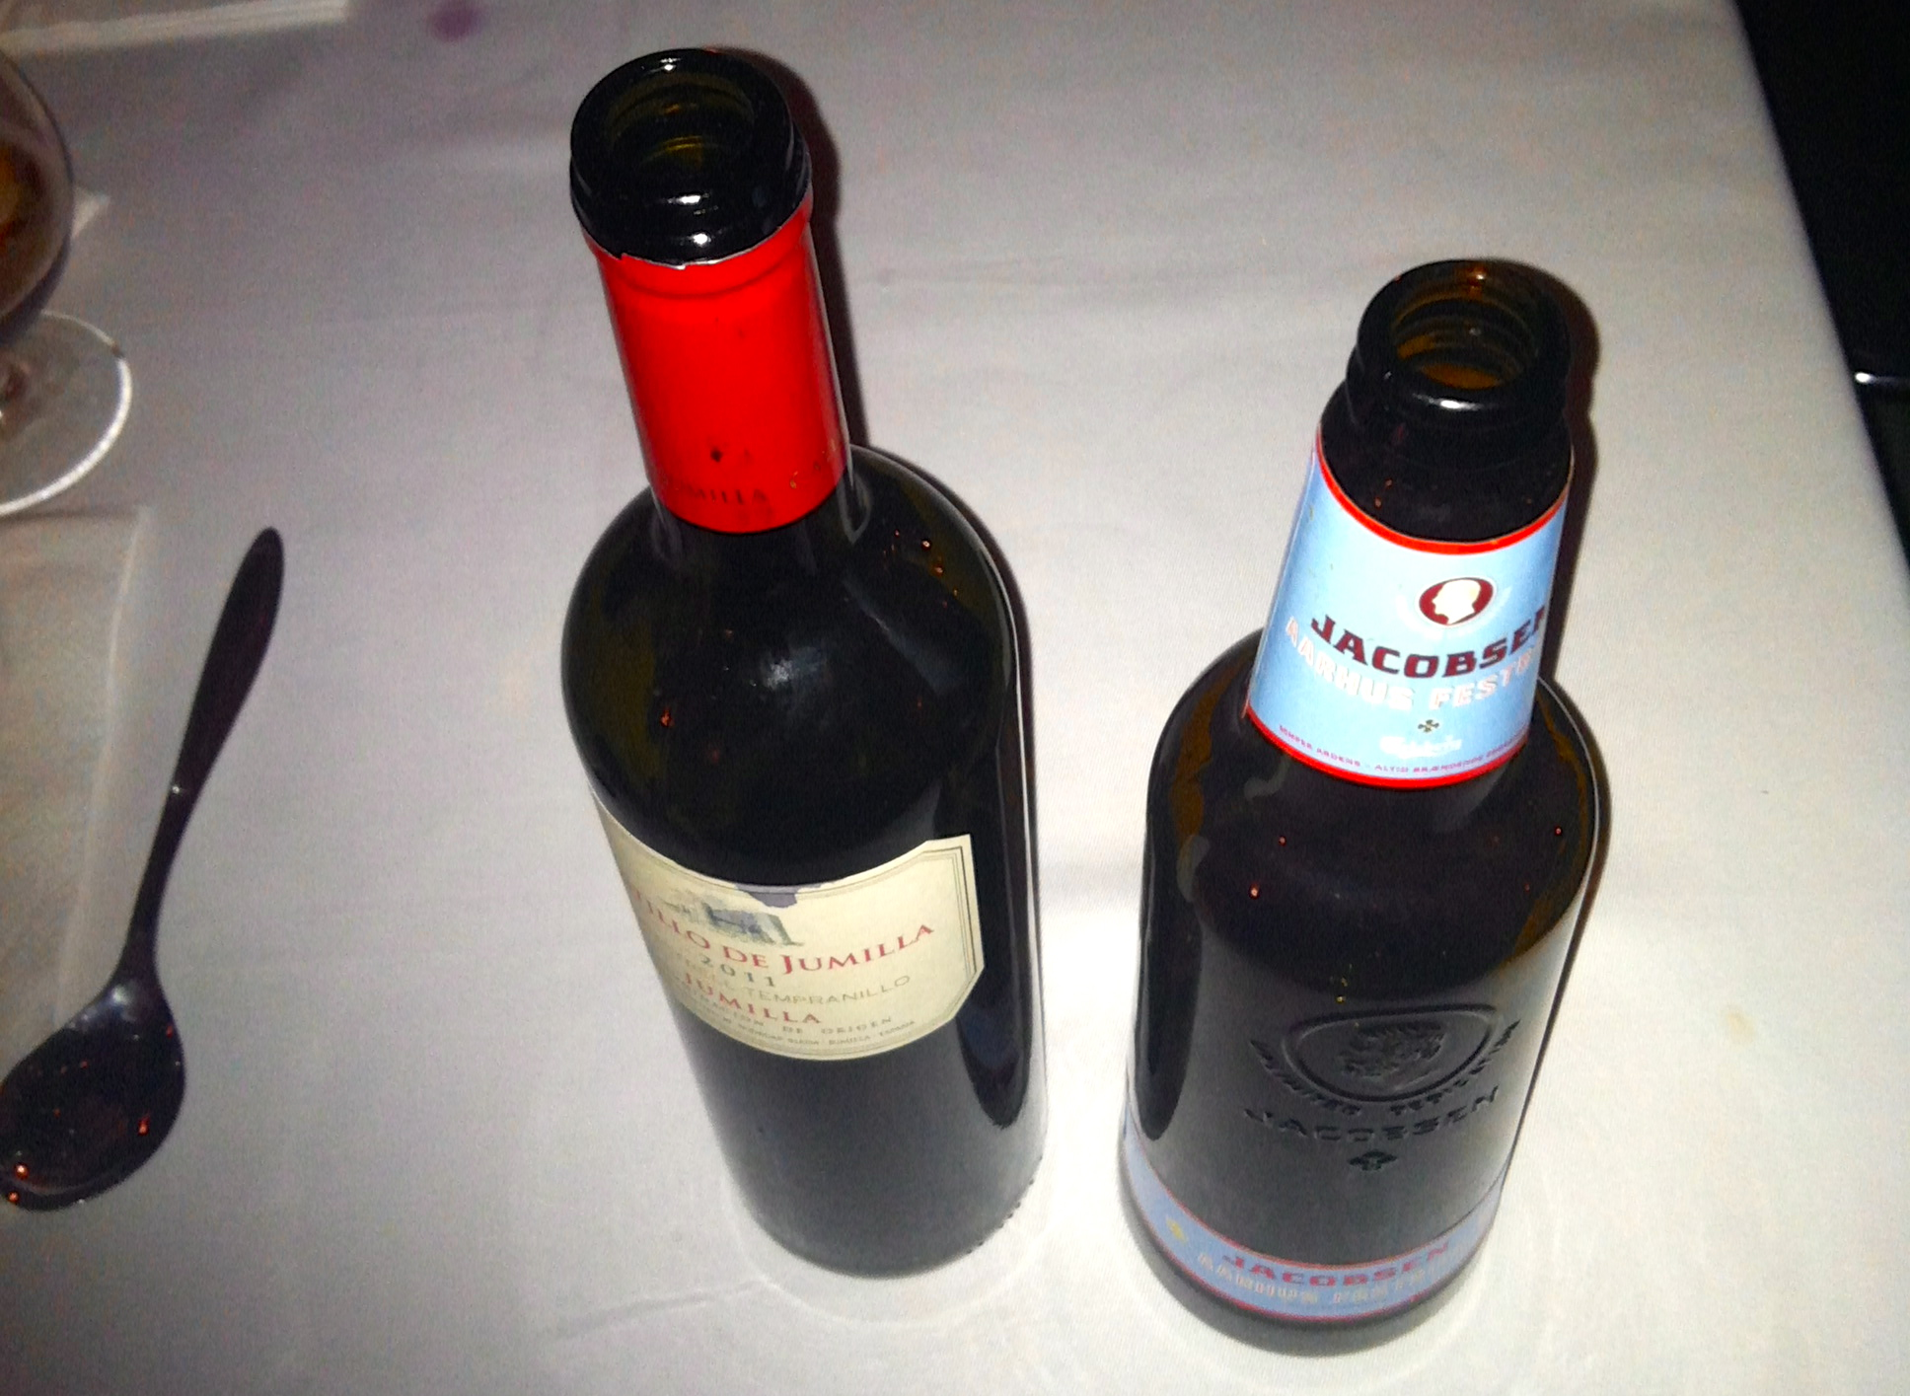
Bottleneck Analysis
July 2013
Adrian Cockcroft
@adrianco

Slide 2
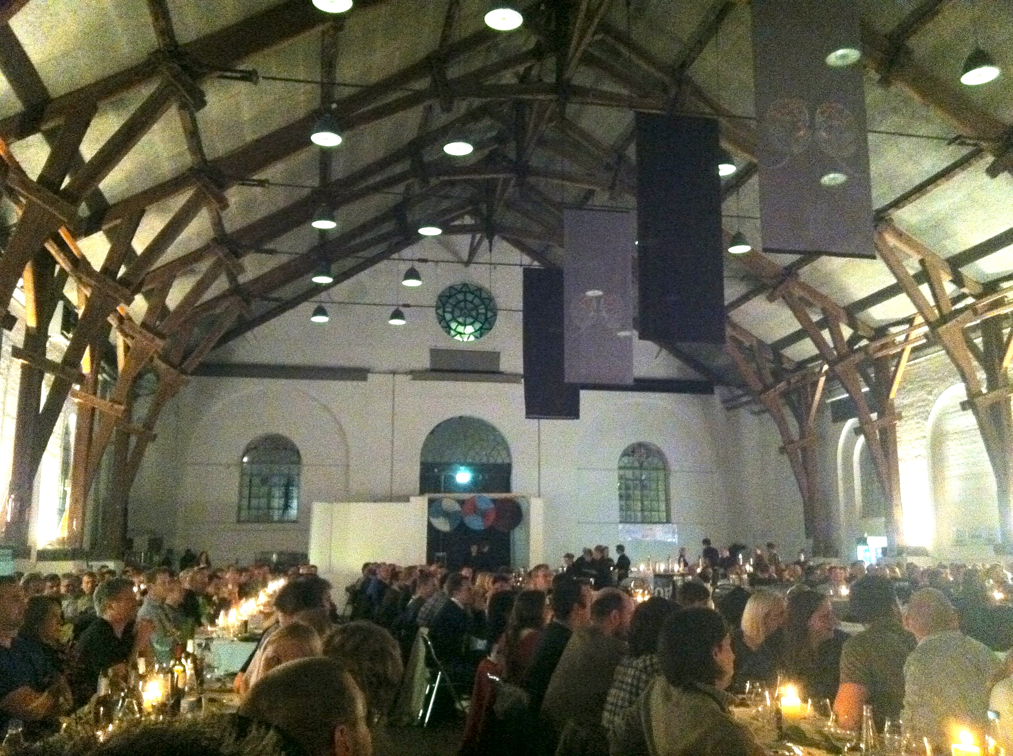

Slide 3
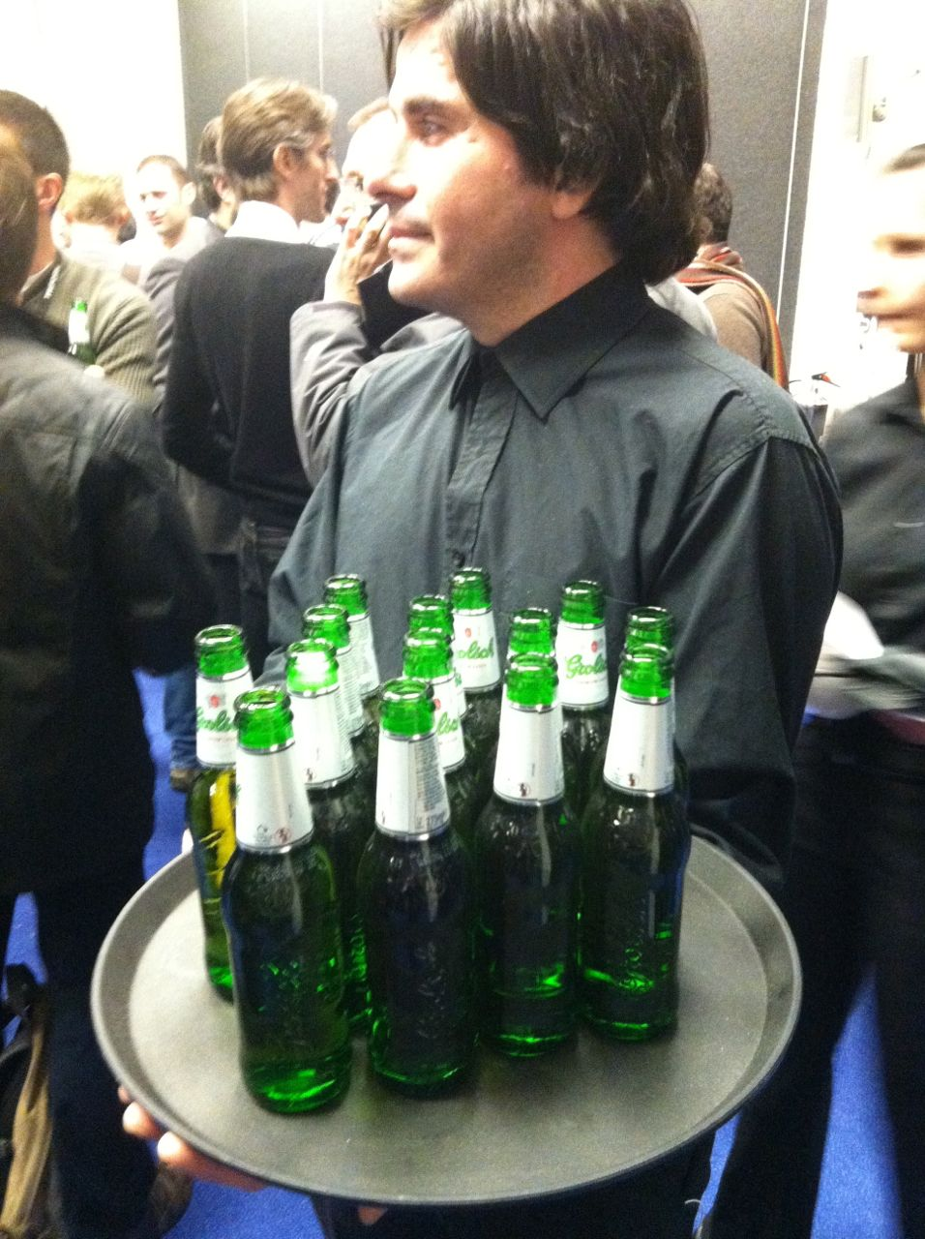

Slide 4
Bottle delivery data
Interval | Response Time | Throughput
10 | 3.1 | 22
20 | 1.2 | 41
30 | 7.9 | 32
… | … | …

Slide 5
Grab some data (using R)
beer <- read.csv(url("http://staash.com/beer_operations.csv"))
response <- beer[,2]
plot(response, type="S",ylab=”response”)

Slide 6
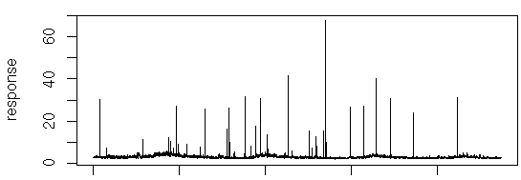
Bottle delivery response over time

Slide 7
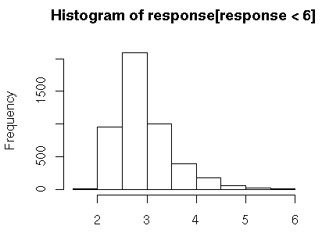
Analysis
> summary(response)
Min. 1st Qu. Median Mean 3rd Qu. Max.
1.909 2.550 2.820 3.086 3.214 67.680
> quantile(response,c(0.95,0.99))
95% 99%
4.149556 6.922115
> sd(response)
1.941328
> mean(response) + 2 * sd(response)
6.968416

Slide 8
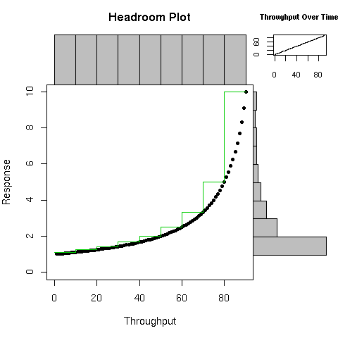
chp(throughput,response,q=1.0)
(See http://perfcap.blogspot.com/search?q=chp)

Slide 9
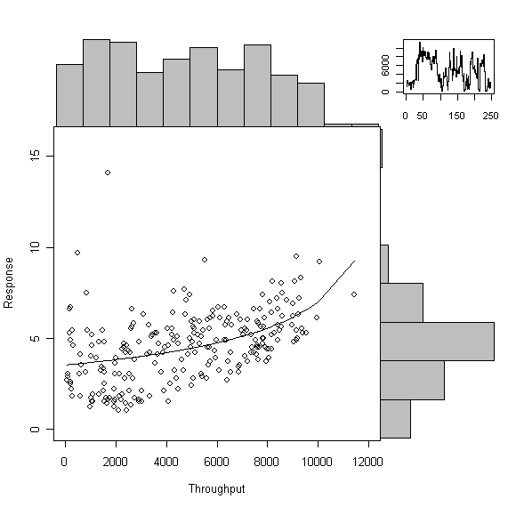

Slide 10
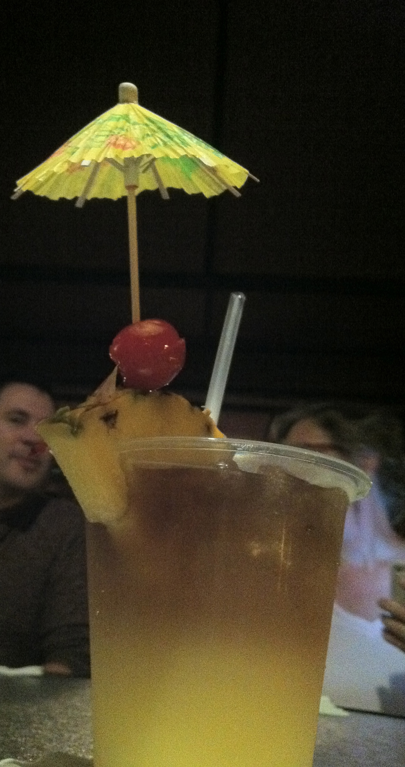

Slide 11
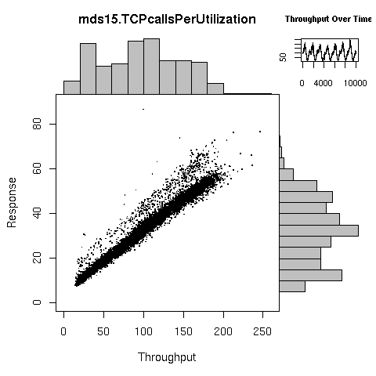

Slide 13
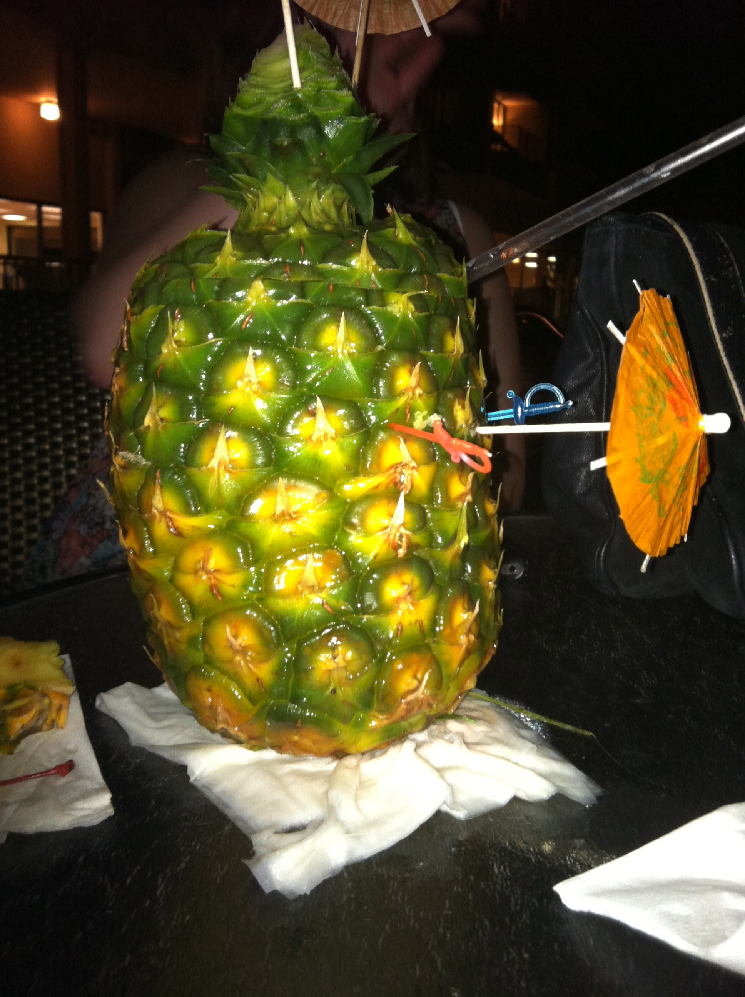

Slide 14
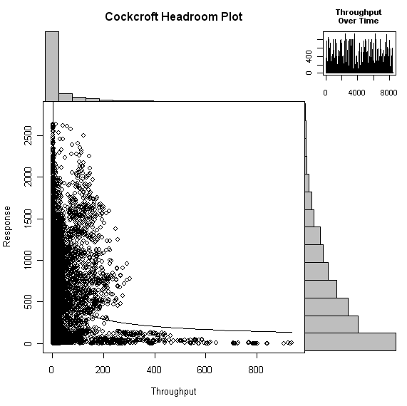

Slide 16
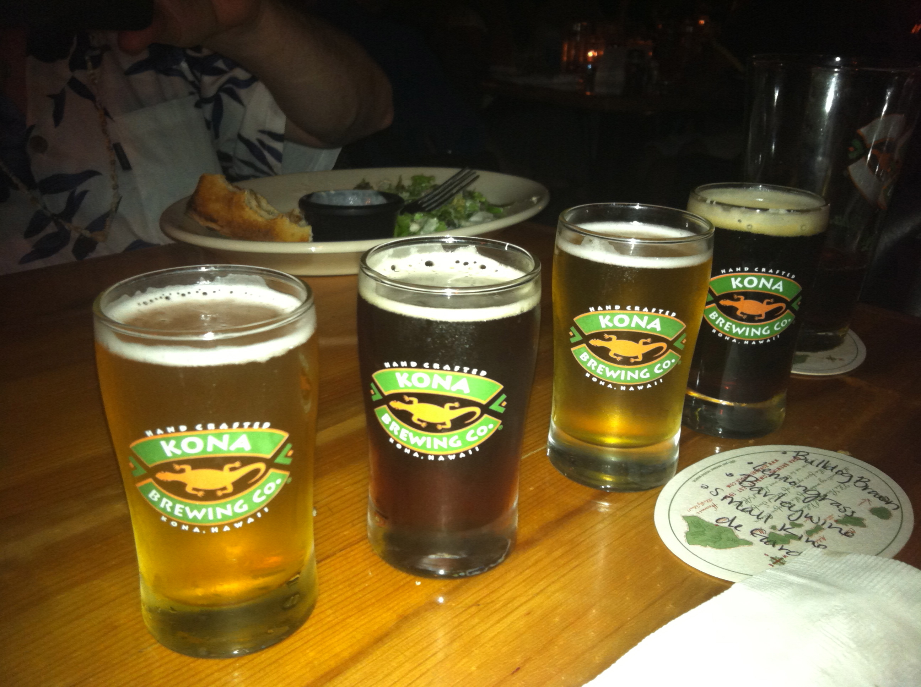

Slide 17
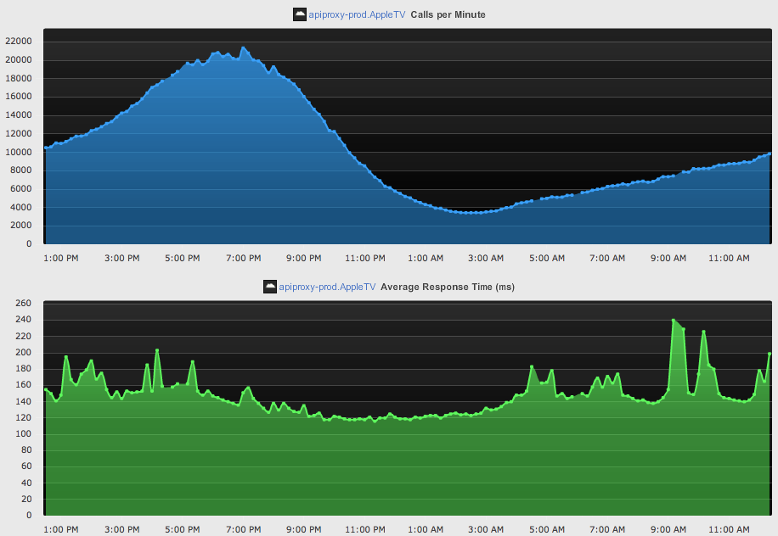

Slide 18
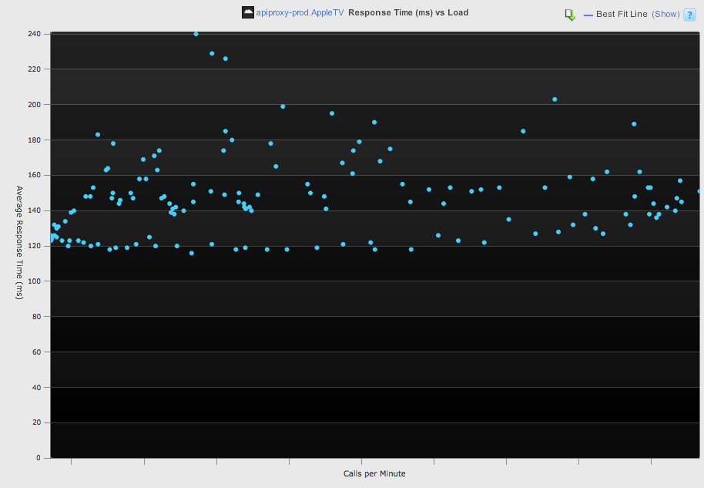
Scalability plots generated using appdynamics.com

Slide 19
Well behaved
Bottlenecks
Lock Contention
Looping autoscaled
Oscillating, thread shortage

Slide 20
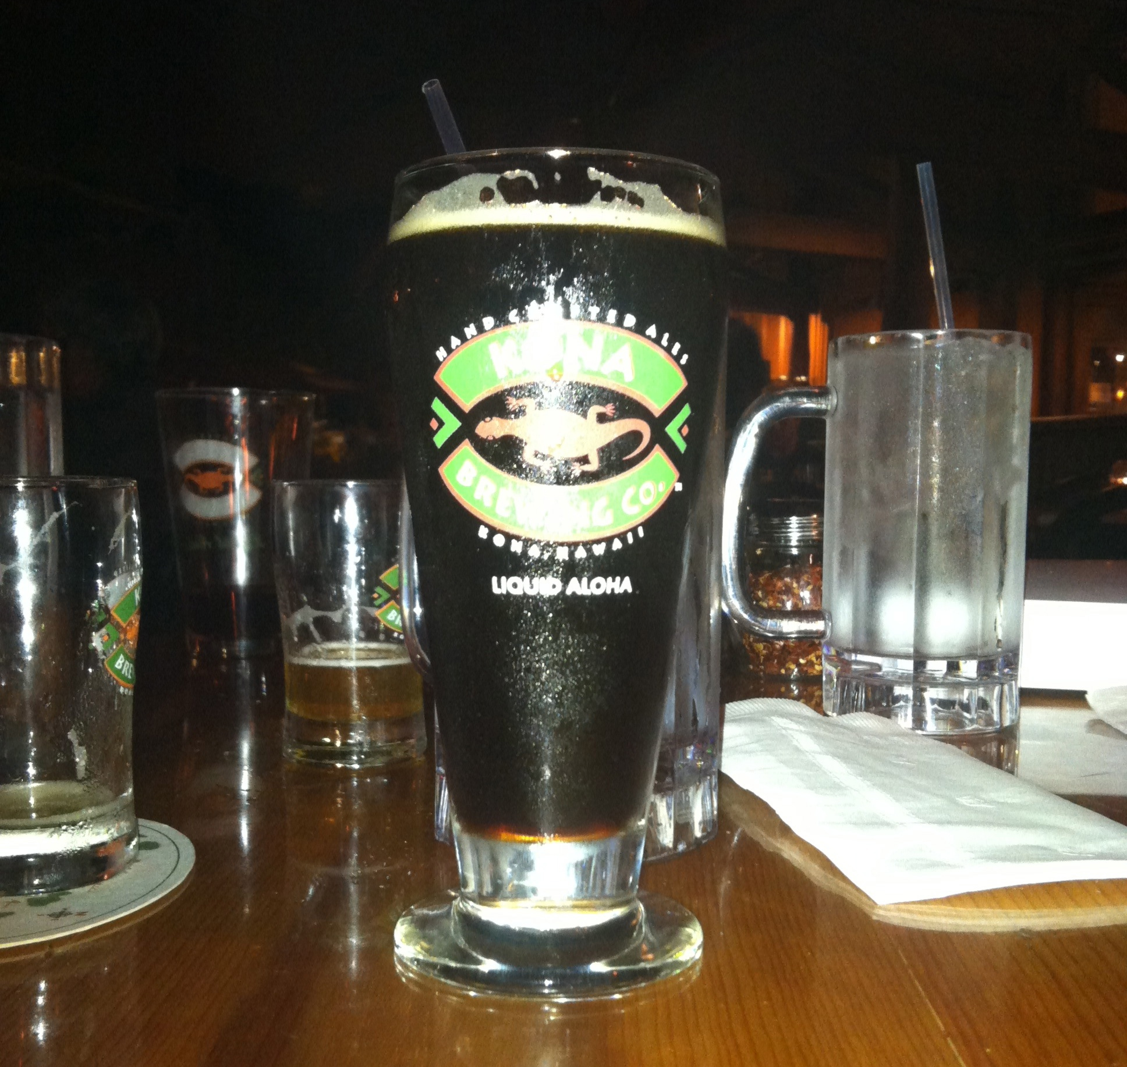
http://perfcap.blogspot.com/search?q=chp
@adrianco

